Slide 1
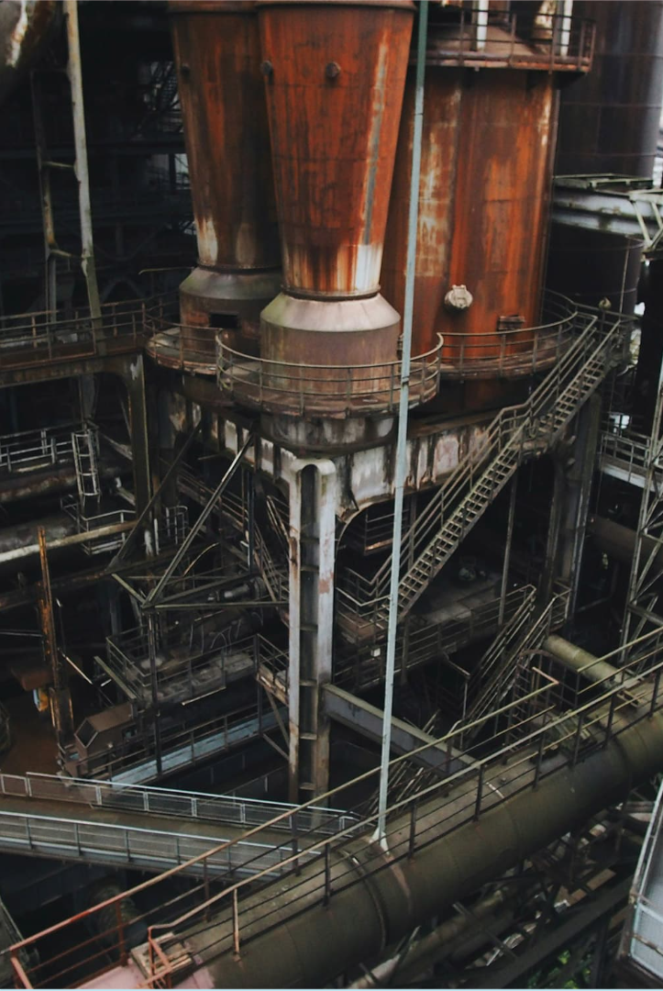

Design of Experiments (DOE) Mobile Application (Sponsored Project)
Shreyash Patil
Aakash Mohale
Vinayak Vathare
Farhan Shaikh

Slide 2
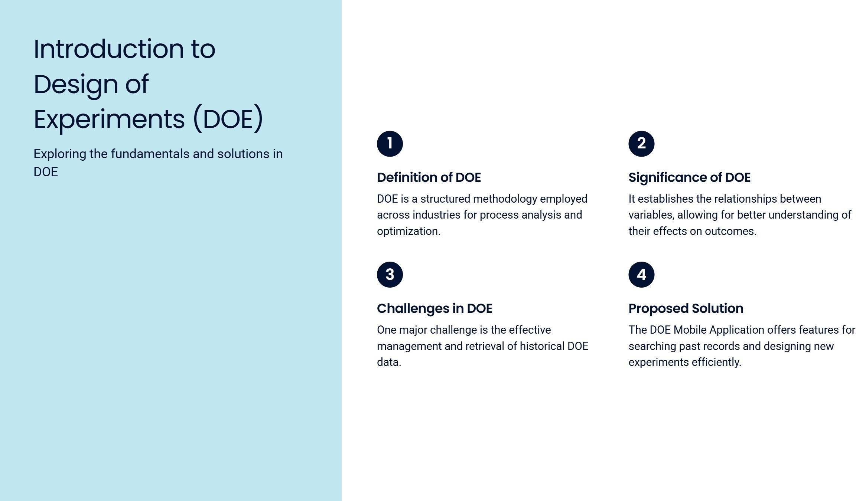

Slide 3
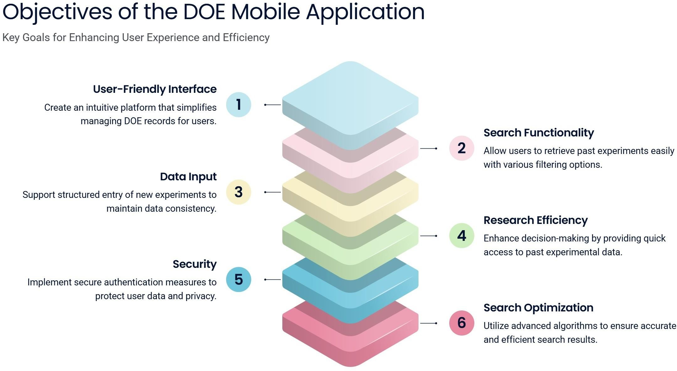

Slide 4
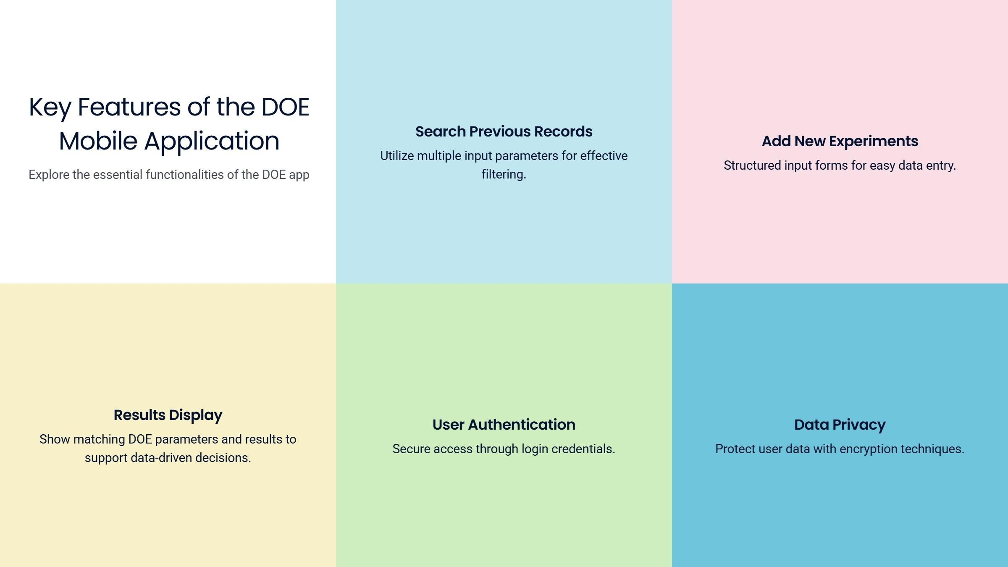

Slide 5
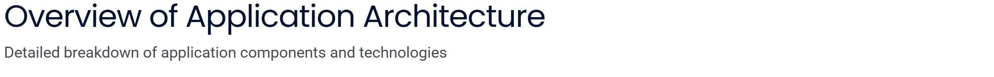
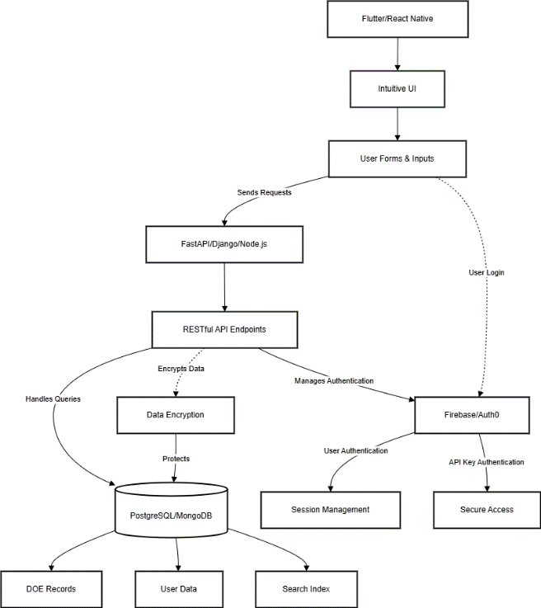

Slide 6
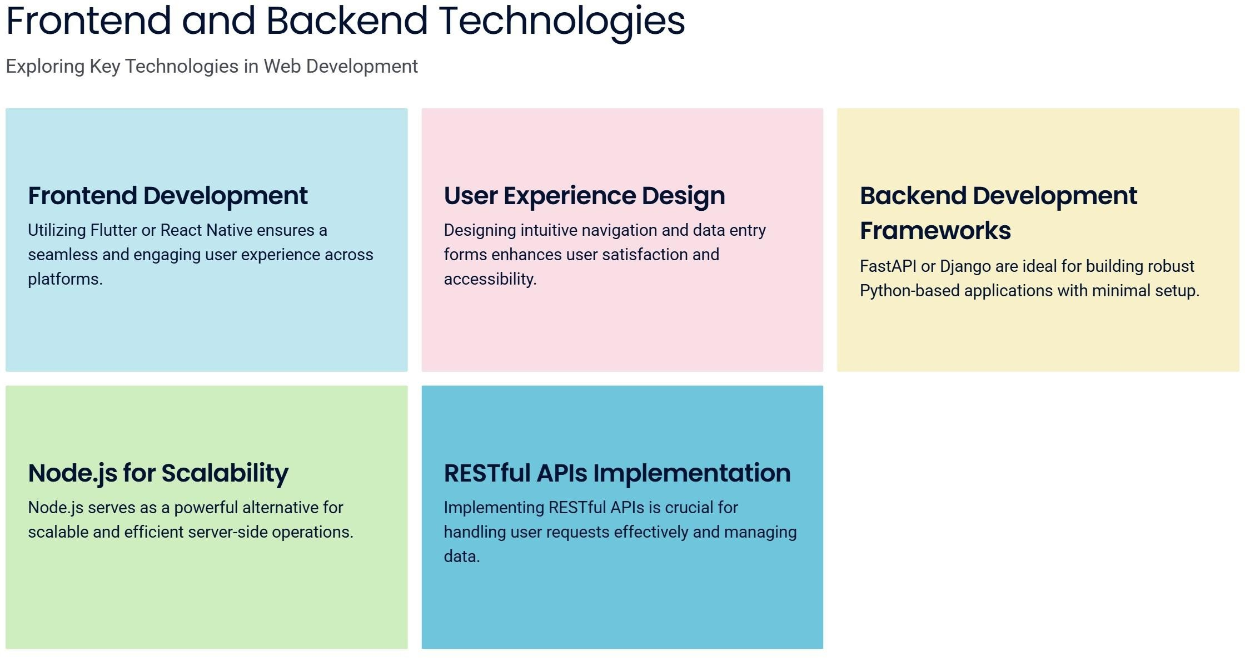

Slide 7
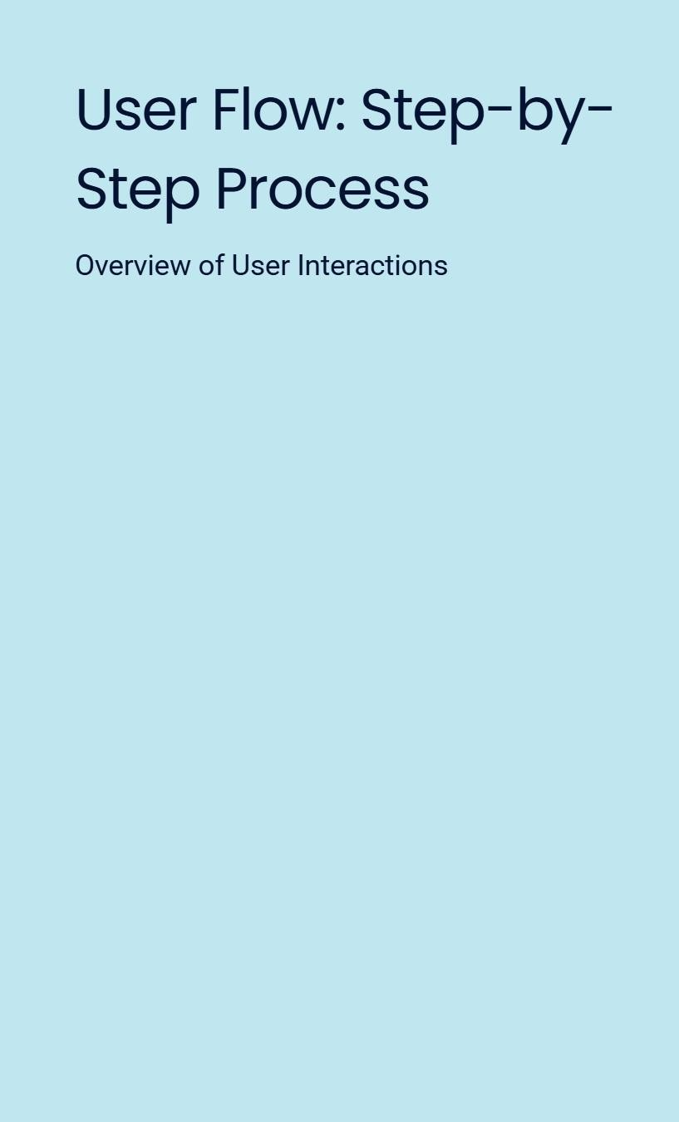
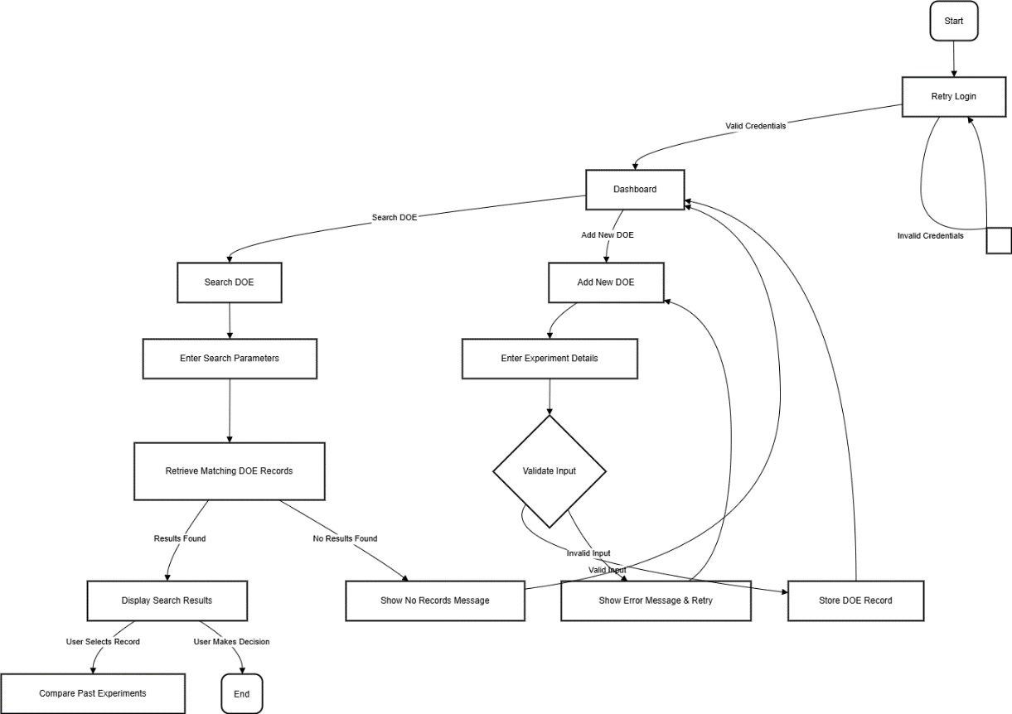

Slide 8
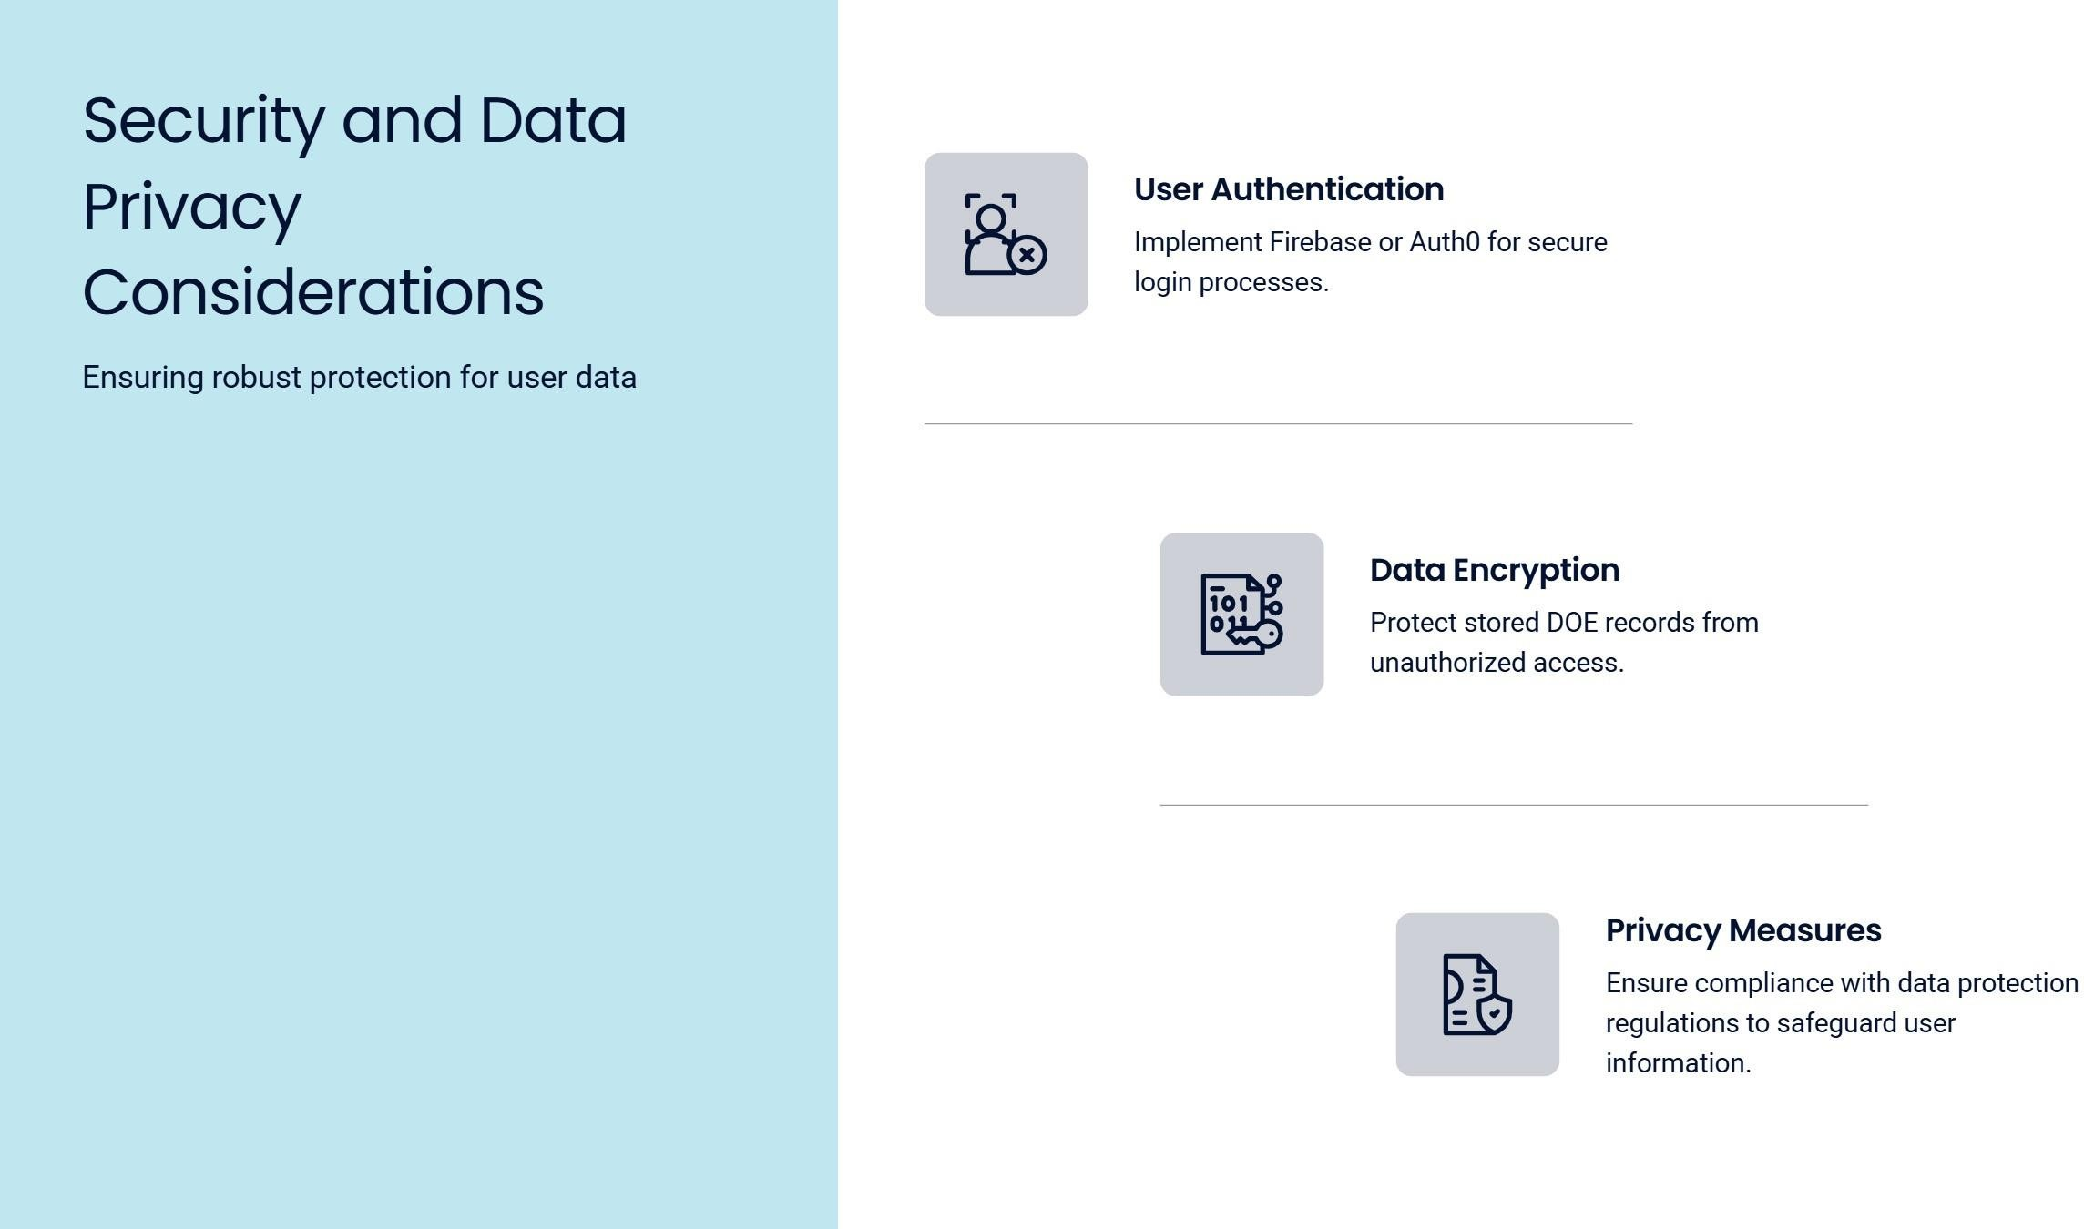

Slide 9
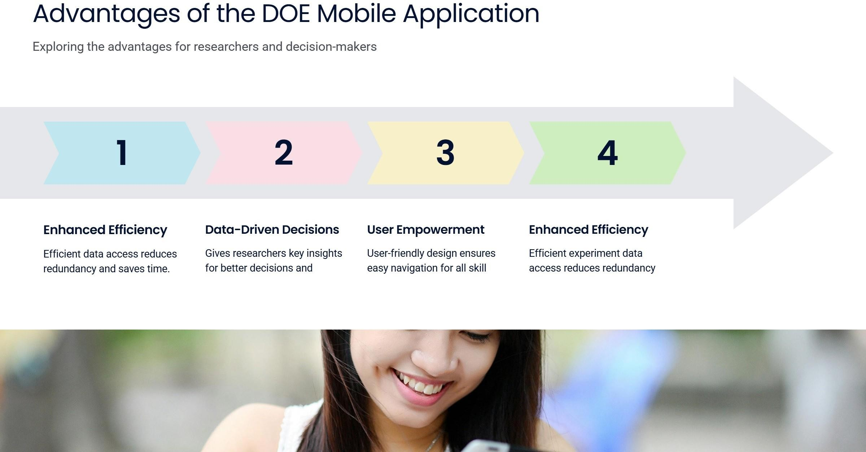

Slide 10
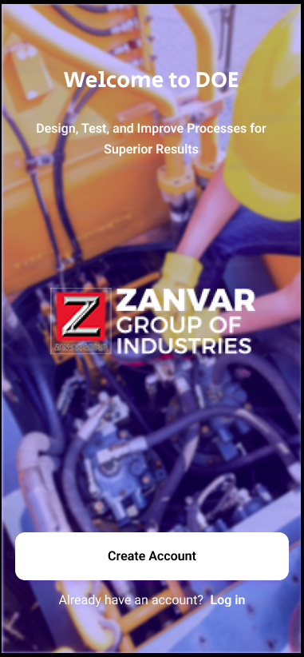
Prototype
Designing
Prototype Design Link :-
https://www.figma.com/design/3IpyUvK1eEIzPbOJ2WQKNj/Zanvar?node-id=0-1&p=f&t=Ld0sccHDcRIjK7cG-0

Slide 11


